Slide 1
Customer Segmentation Using RFM and K-Means
Ai Saturdays Lagos- ML Flipped Cohort 9
July - October 2025
Simeon Musa Nyakeh Vibbi
Notes:
Good day everyone, my name is Simeon Vibbi, and this is my final capstone project for the AI Saturdays Lagos Machine Learning Flipped Cohort. My project focuses on applying machine learning to understand customer behavior, specifically through segmentation using RFM analysis and K-means clustering. The goal is to help businesses identify their most valuable, at risk and potential customers through data.

Slide 2
PROJECT OVERVIEW
Selling your idea
Objective: Identify and group customers by purchasing patterns
Methods: RFM and K-Means clustering
Value: Enables targeted marketing and improved customer retention
Notes:
This project was designed to demonstrate practical application of what we learned, using data to solve real business problems. Many retail business collect data but don’t use it effectively. My project uses RFM metrics - Recency, Frequency, and Monetary, to segment customers, then applies K-Means clustering to group them into meaningful categories. The insights can be used by marketing or sales teams to focus on the right customers at the right time.

Slide 3
Problem Statement
Businesses lack actionable insight from customers data
Marketing campaigns are often broad and ineffective
Need: Identify customer groups based on behaviors
Notes:
Most businesses treat all customers equally, everyone gets the same emails, the same offers.
This leads to wasted marketing budget and lost opportunities.
The problem i am solving is: How can a business use its data to identify who its top customers are, who might churn soon, and who can be re-engaged.
That’s where the segmentation comes in.

Slide 4
DATASET DESCRIPTION
Source: Kaggle- Retail Sales Dataset
Columns: Customer ID, Order ID, Order Date, Quantity, Unit Price, Amount
Objective: Generate RFM features for each customer
Notes:
The dataset used simulates retails transactions, basically sales records with customer IDs, purchase amount and dates.
From this, I derived key RFM features that summarize each customer’s behavior.
Even though it’s a generic dataset, the methods and insights apply directly to real-world businesses.

Slide 5
Feature Engineering (RFM Model)
Recency = Days since last purchase
Frequency = Number of purchases
Monetary = Total spending
Aggregated by customers ID
Notes:
RFM stands for Recency, Frequency, and Monetary, three metrics that describe how customers behave.
Recency tells how recently they bought, lower is better
Frequency tells how much they buy, higher is better
Monetary tells how mucg they spend, higher means more valuable
These three features become the foundation for clustering customers into meaningful groups.

Slide 6
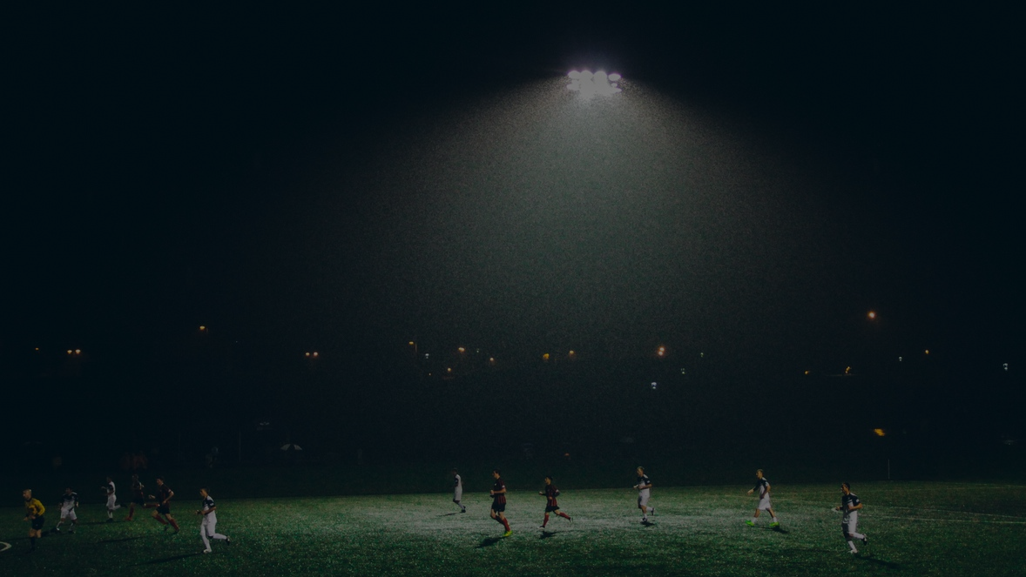
Modeling Approach
Scaled RFM features using RobustScaler
Tested different cluster number (k = 2-8)
Evaluated using:
Elbow Method (inertia)
Silhouette Score (cluster separation)
Notes:
Before applying K-Means, I scaled the data to ensure that all RFM features contributed equally, since K-Means is sensitive to magnitude differences.
Then, i tested multiple values for k, the number of clusters no longer improved performance significantly, and Silhouette Score helped me confirm which number of clusters produced the most well-separated groups.

Slide 7
Persona Mapping
Assigned intuitive labels to each cluster
Champions
Loyal
Promising
At Risk
Hibernating
Based on Recency, Frequency, and Monetary averages
Notes:
K-Means gives numeric clusters, but numbers alone don’t tell a story.
To make the results business-friendly, i assigned each cluster a persona name.
For example:
Champions buy often, spend the most, and purchase recently
At Risk customers haven’t bought in a while.
Hibernating customers might be inactive entirely.
These labels make it easier for non-technical stakeholders to understand and act on the insights

Slide 8
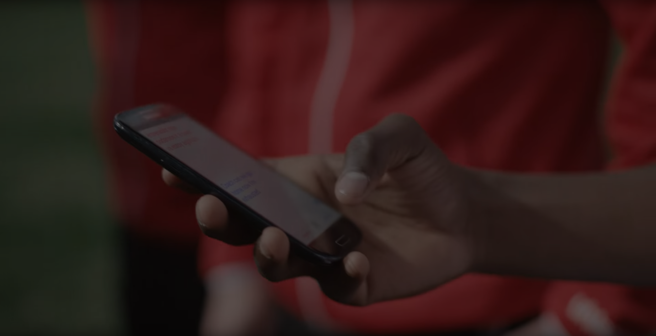
Purpose: Validate clustering results and visualize customer patterns
Visualized:
Segment distribution
Average RFM metrics
Correlations among features
Exploratory Data Analysis (EDA)
Notes:
After clustering, i conducted an Exploratory Data Analysis to better understand each group.
The goal was to visualize how these cluster differ, in terms of renceny, spending, and purchase frequency and confirm that the segmentation made sense statistically and visually

Slide 9
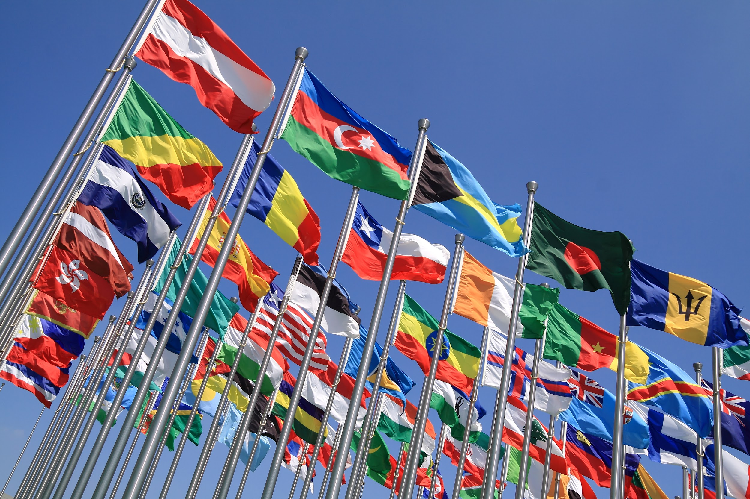
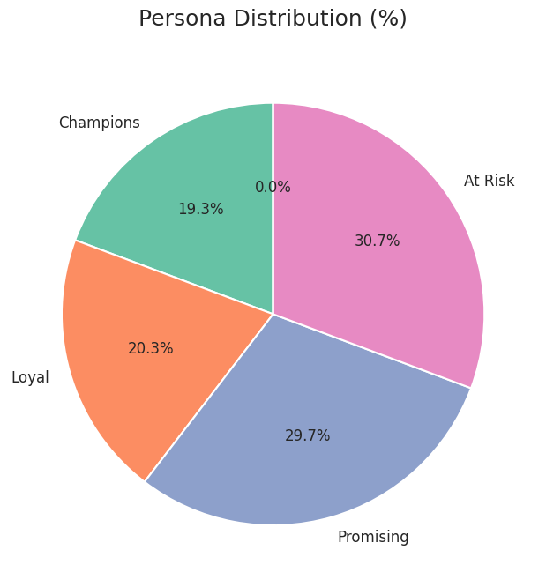
Segment Distribution
Notes:
Here is the distribution of the customer base
The majority of customers are either Promising or at Risk.
This tells us that while we have strong potential customers, larger portion of them are also slipping away, which highlights an opportunity for marketing to focus on retention

Slide 10
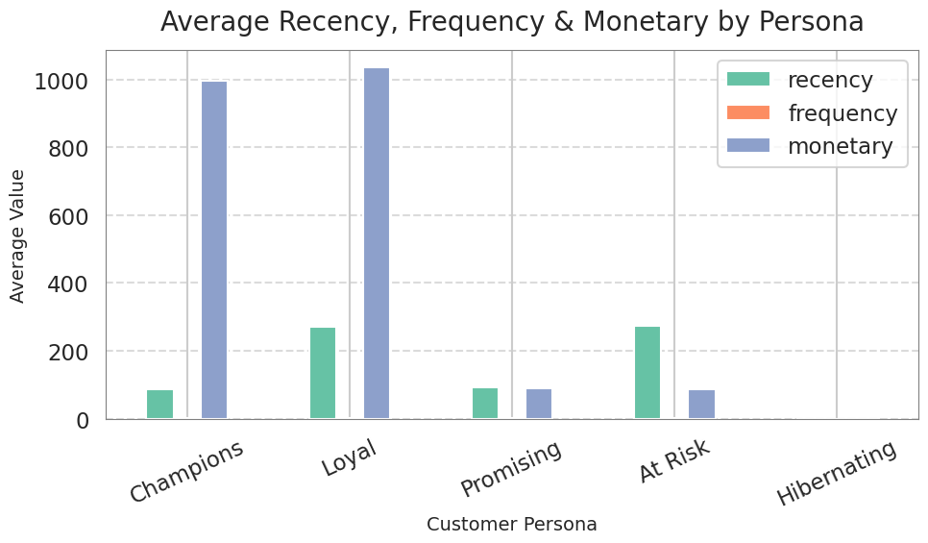
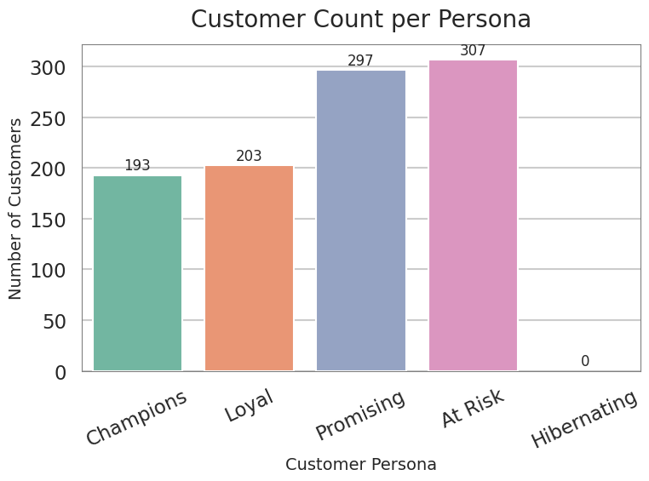
Customer Count per Persona
Notes:
his visualization shows the number of customers in each persona group based on our segmentation results.
From the chart, we can see that the largest customer segments are At Risk and Promising, followed by Loyal and Champions. This means that while we have a solid base of loyal and high-value customers, a significant portion of our customers are either showing early signs of disengagement (At Risk) or are still developing their relationship with the business (Promising).
The smaller share of Champions indicates that only a few customers make frequent, high-value, and recent purchases — they represent our top-tier customers.
Having many Promising customers is actually a positive sign — it shows potential for growth if we can engage and convert them into more frequent buyers.
On the other hand, the At Risk group should be a priority for the marketing team because they’re on the verge of becoming inactive. If not re-engaged, they could move into the Hibernating segment over time.
Overall, this chart provides a quick overview of our customer base structure and highlights where to focus retention and engagement efforts.

Slide 11
Average RFM Persona
Notes:
This Chart shows that Champions and Loyal customers purchase more recently and spend significantly more than others.
At Risk and Promising customers have similar purchase frequency but much higher recency, meaning they haven’t bought in a long time.

Slide 12
Champions & Loyal – Most valuable customers
At Risk – Need reactivation campaigns
Promising – High potential, need nurturing
Hibernating – Currently inactive or missing data
Key Insights
Notes:
The insights tell a clear story:
Champions and Loyal are our main revenue drivers, we have to keep them happy.
At Risk customers are at a critical point , one campaign could bring them back.
Promising customers need encouragement to buy again.
Hibernating might require a win-back campaign or data audit. This shows the power of segmentation , now we can take targeted action.

Slide 13
Reward & retain Champions & Loyal customers
Re-engage At Risk customers
Nuture Promising customers
Reactivate Hibernating Customers
Encourage repeat purchase across all groups
Recommendations
Notes:
The next step is turning insights into action:
Keep your best customers by rewarding them.
Reconnect with customers before they churn.
Turn first-time buyers into loyal ones.
And overall, increase repeat buying through loyalty programs or bundles. These are actionable, data-backed strategies any business can implement.

Slide 14
Tools and Libraries
Python (pandas, numpy, scikit-learn)
Seaborn and Matplotlib for visualization
Google Colab for development
Dataset from Kaggle
Notes:
All of this was implemented in Python using standard data science libraries.
Google Colab provided an environment for code, visuals, and documentation — making the analysis fully reproducible.

Slide 15
Conclusion
RFM and K-Means = actionable segmentation
Identified 5 customer groups with clear behaviors
Framework helps guide marketing strategy and retention

Slide 16
Next Steps
Deploy model using Streamline
Integrate real-time customer data
Add new features (demographics, product type)
Notes:
Looking ahead, this project can evolve into a real application.
I plan to deploy it as a Streamlit dashboard where marketers can input customer data and see segment predictions.
I can also enhance the model with demographics or geographic data to make it even more powerful.

Slide 17
Acknowledgements
AI Saturdays Lagos - ML Flipped Cohort 9
Facilitators: Tejumade A, Yanmife
Mentors and community members
Notes:
“I’d like to thank the AI Saturdays Lagos team for organizing such an impactful program, especially my facilitator Tejumade and all the mentors who guided us.
This project reflects what I’ve learned..

Slide 18
THANK YOU/Q&A
LinkedIn
Notes:
Thank you all for your attention.
I’m happy to take any questions about the project, the data, or the process.
You can also connect with me on LinkedIn to follow my journey.

